Slide 1
Freight and Passengers Transportation
Meeting #3
Organization of transportation
Lecturer: | Ph.D. ing. Aleksandrs Kotlars

Slide 2
Topics for today
International transportation practical task

Slide 3
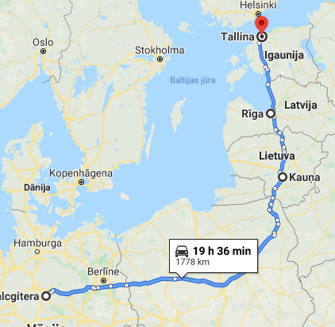
Conditions
The goods are delivered from Germany (production plant) to workshops in Lithuania, Latvia and Estonia.
Loading address - 38239 Salzgitter, Germany.
Delivery places in the Baltic:
UAB Adampolis, Kaunas, Lithuania
Keil MA OUE, Tallinn, Estonia
AVAR AUTO SIA, Riga, Latvia
The goods are dispatched from Germany regularly, 3 times a week, according to the following schedule:
Mondays, 10:00 a.m.
Wednesdays, 10:00 a.m.
Fridays, 10:00 a.m.

Slide 4
To do
You will have to evaluate 2 scenarios for setting up a delivery system:
Direct road deliveries with multi-stops.
Deliveries using ferry connections between Germany and the Baltic States and local distribution hub in Baltic country.
Follow the steps below to complete the task:
Study the shipment statistics (historical annual data) and select a representative month for the calculation.
For better visibility, arrange the data in a pivot table.
Examine the cost structure for the different transportation stages.
Explore online resources with ferry connections in Europe and select the connection that best suits your needs.
Do the calculations for scenarios 1 and 2.

Slide 5
Scenario 1
Multi-stop delivery scheme.
Goods are loaded in Germany and delivered to the Baltics using FTL multi-stop solutions.
Delivery time (transit time) is up to 3 working days.
Do the steps below:
Calculate the distance from the loading point in Germany to each destination in the Baltic States.
Calculate how many vehicles are needed (and what type of vehicles).
Apply appropriate transport tariffs per kilometre.
Calculate the total transport costs.
Calculate additional costs for multiple stops.

Slide 6
Scenario 2
Deliveries with ferry and local distribution hub.
All deliveries must be made within 48 h (transit time).
Loading schedule in Germany:
Monday, 10:00 a.m. >>> delivery on Wednesday
Wednesdays, 10:00 a.m. >>> delivery on Friday
Fridays, 10:00 a.m. >>> delivery on Monday
To ensure this delivery schedule, following option must be considered:
Pre-carriage from Salzgitter to a seaport in Germany (to be chosen by you!)
Ferry from Germany to a Baltic port (to be chosen by you!)
Transshipment to warehouse (location to be chosen by you!)
Last mile distribution in the Baltic States
Ferry routes can be found here: https://www.europeantransportmaps.com/map/roro-ferry
Example: https://www.dfds.com/lv-lv/kravu-parvadajumi/marsruti-un-kustibas-saraksti/klaipeda-kile

