Slide 1
Planning and Decision Making

Slide 2
Planning
Choosing a goal
Developing a method or strategy to achieve that goal
Double-edged sword

Slide 3
Benefits and Pitfalls of Planning
Benefits
Employee efforts intensified
Leads to persistence
Provides direction
Encourages the development of task strategies -
Works for companies and individuals
Pitfalls
Impedes change
Prevents or slows needed adaptation
Creates a false sense of certainty – based on “assumptions” of what the future holds
Detachment of planners

Slide 4
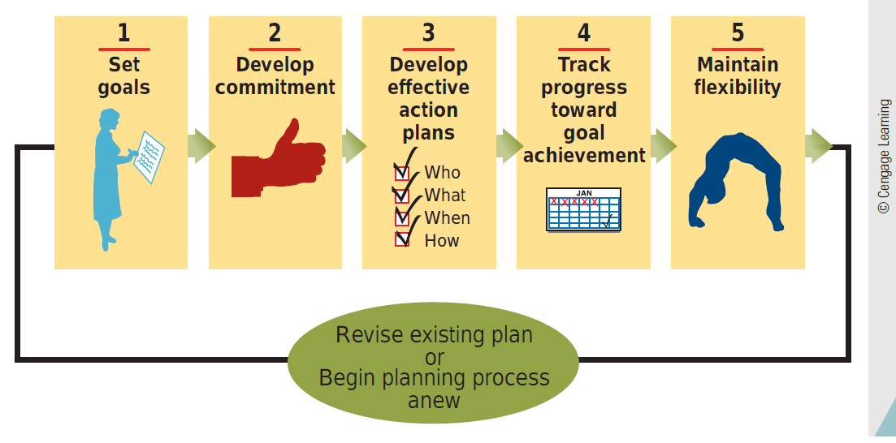
How to Make a Plan That Works

Slide 5
Setting Goals
Effective Planning
S.M.A.R.T. Goals
Specific
Measurable
Attainable
Realistic
Timely

Slide 6
Developing Commitment to Goals
Effective Planning
Goal commitment is the determination to achieve a goal
Techniques
Set goals collectively
Make the goal public
Obtain top management’s support

Slide 7
Develop Effective Action Plans
Effective Planning
An action plan lists…
Specific steps (how)
People (who)
Resources (what)
Time period (when)
…for accomplishing a goal

Slide 8
Tracking Progress
Effective Planning
Set proximal goals (short-term) and distal goals (long-term)
Gather and provide performance feedback
Needs to be regular and frequent to allow for adjustments

Slide 9
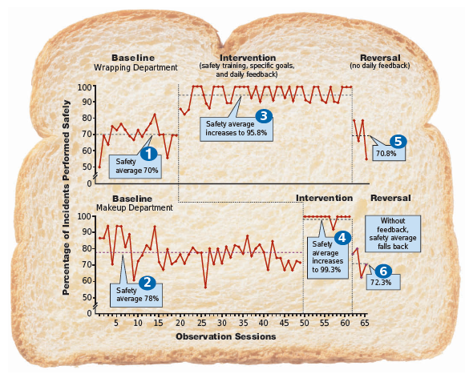
Effects of Goal Setting, Training, and Feedback on Safe Behavior in a Bread Factory

Slide 10
Maintaining Flexibility
Effective Planning
Options-based planning
keep options open by making, small simultaneous investments in many alternative plans.
Slack resources
a cushion of resources, like extra time or money, that can be used to address and adapt to unanticipated changes.

Slide 11
Planning from Top to Bottom
Top management (long-term, conceptual)
Responsible for developing long term strategic plans
Strategic plans make clear how to serve customers and position against competitors for next 2 – 5 years
Purpose statement: Declaration of a company’s purpose or reason for existing (mission or vision)
Brief, clear, inspirational, consistent, and enduring
Strategic objective: Specific goal derived from the purpose statement
Unifies company-wide efforts
Stretches and challenges the organization
Possesses a finish line and a time frame

Slide 12
Planning from Top to Bottom
Middle management
Responsible for developing and carrying out tactical plans to accomplish strategic objective
Tactical plans: Specify how the company will use resources, budgets, and people to accomplish specific goals
Time frame – 6 months to 2 years
Management by objectives: 4 step process used my managers and employees
Discuss goals
Collectively select goals
Jointly develop tactical plans
Meet regularly to review progress toward goal accomplishment

Slide 13
Planning from Top to Bottom
First-level managers
Responsible for developing and carrying out operational plans – day-to-day plans
Time Frame – 30 days to 6 months
Operational plans
Single-use plans: Cover unique, one-time-only events
Standing plans: Used repeatedly to handle frequently recurring events
Policies – what to do if “x” happens
Procedures – more specific than polices
Rules & Regulations – even more specific than procedures
Budgeting: Managers decide how to allocate available money to best accomplish company goals

Slide 14
Steps to Rational Decision Making
1. Define the problem
Problem: Gap between a desired state and an existing state
Managers must:
Be aware of a problem
Be motivated to solve the problem
Have the knowledge, skills, abilities, and resources to fix the problem
2. Identify decision criteria
Decision criteria: Standards used to guide judgments and decisions

Slide 15
Steps to Rational Decision Making
3. Weigh the criteria
Absolute comparisons: Each decision criterion is compared to a standard or ranked on its own merits
Relative comparisons: Each decision criterion is compared directly with every other criterion

Slide 16
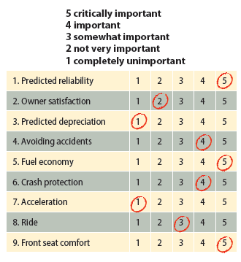
Absolute Weighting of Decision Criteria for a Car Purchase

Slide 17
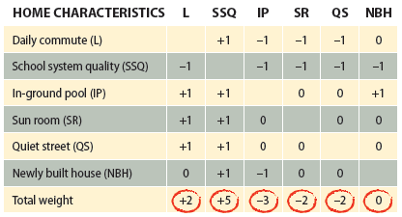
Relative Comparison of Home Characteristics

Slide 18
Steps to Rational Decision Making
4. Generate alternative courses of action
5. Evaluate each alternative
Involves systematically evaluating each alternative against each criterion
6. Compute the optimal decision
Performed by multiplying the rating for each criterion by the weight for that criterion, and then summing the generated scores

Slide 19
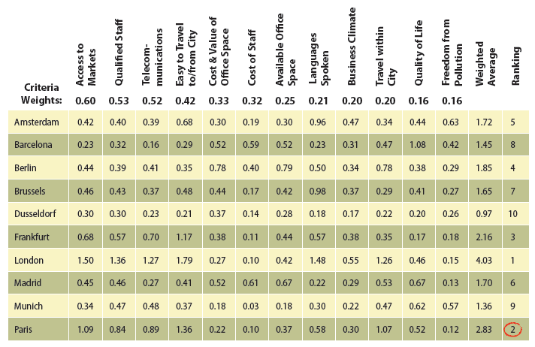
Criteria Ratings Used to Determine the Best Location for a New Office

Slide 20
Limits to Rational Decision Making
Managers have to operate in a perfect world with no real-world constraints
Limited resources as well as attention, memory, and expertise problems make it difficult for managers to maximize decisions
Satisficing: Choosing a good-enough alternative

Slide 21
Advantage and Pitfalls of Group Decision Making
Advantages
In the decision-making process groups perform better than individuals in:
Defining the problem
Generating alternative solutions
Pitfalls
Groupthink: Barrier to good decision making
Intense pressure to agree with each other
Takes considerable time
Meeting complaints
Individuals can dominate group discussions
Equality Bias – individuals treat all group members as equally competent

Slide 22
Avoiding Pitfalls Using Groups to Improve Decision Making
Structured conflict - Right kind of conflict can lead to better group decision making
C-type (cognitive) conflict
Focuses on problem- and issue-related differences of opinion
Willingness to examine, compare, reconcile differences to produce the best possible solution
A-type (affective) conflict
Focuses on individuals or personal issues
Emotional reaction that can occur when disagreements become personal
Hostility, anger, resentment, distrust, cynicism, apathy

Slide 23
Creating C-Type Conflict
Devil’s advocacy
Dialectical Inquiry – propose solution (thesis), then generate an opposite proposal (antithesis)
Nominal Group Technique – Begins and ends by having group members write down and evaluate ideas
Shared with the group
Improves group decision making by decreasing a-type conflict
Delphi Technique
Don’t have to meet face-to-face
Members of a panel of experts respond to questions and to each other until reaching agreement on an issue
Brainstorming/Electronic brainstorming – all anonymous
Group members use computers to build on each others’ ideas
Generate as many alternative solutions as possible

Slide 24
Summary
Planning brings about increase in individual and organizational performance
Planning works best when the goals and action plans at the bottom and middle of the organization support the goals and action plans at the top of the organization
Decision making the process of choosing a solution from available alternatives

Slide 25
Key Terms
Planning
S.M.A.R.T. goals
Goal commitment
Action plan
Proximal goals
Distal goals
Options-based planning
Slack resources
Strategic plans
Purpose statement
Strategic objective
Tactical plans
Management by objectives
Operational plans
Single-use plans
Standing plans
Policies
Procedures
Rules and regulations
Budgeting
Decision making
Rational decision making
Problem
Decision criteria

Slide 26
Key terms
Absolute comparisons
Relative comparisons
Maximize
Satisficing
Groupthink
C-type conflict
A-type conflict
Devil’s advocacy
Dialectical inquiry
Nominal group technique
Delphi technique
Brainstorming
Electronic brainstorming
Production blocking
Evaluation apprehension

